Slide 1
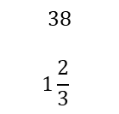
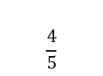
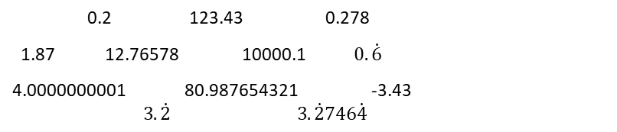
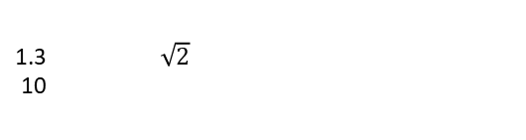
Subtopic N1.8 – Order a List of Decimals
LEARNING OUTCOME: To understand how to order decimals.
Objectives:
Keywords:
Decimal
Place Value
Ascending
Descending
To order decimals using a number line.
To order decimals without a number line.
To solve problems involving ordering decimals.
Introduction – Read and annotate:
Similar to ordering integers, ordering a list of decimals involves arranging numbers from smallest to
largest (or vice versa) by comparing their place values. This extends our skills with whole numbers to
include decimals, strengthening our ability to accurately read, write, and compare numbers.
Definition
Characteristics
A decimal is a number that is not whole, as it lies between whole numbers.
Consists of a whole and a fraction part.
The fractional part is written as digits after a point rather than a fraction.
The whole and fraction parts are separated by a point called the decimal point.
Can be terminating or recurring.
Examples
Decimal
Non - Examples
240
 | Example 1 - I do… | Example 2 – We do… | Example 3 – You do…
Steps | Place the following numbers in ascending order: | Place the following numbers in ascending order: | Place the following numbers in ascending order:
1) Look at the place value of the leftmost digit. Write down the number with the smallest place value. 2) If any have the same place value, look at the digit to the right and write down the number with the smallest value. Repeat until all numbers have been ordered. | 4.2, 4.5, 4.3 4.2, 4.3, 4.5 | 4.61, 4.21, 4.67 4.21, 4.61, 4.67 | 4.17, 4.68, 4.14 4.14, 4.17, 4.68
 | 4.35, 4.31, 4.6 4.31, 4.35, 4.6 | 0.31, 0.301, 0.312, 0.23, 0.2 0.2, 0.23, 0.301, 0.31, 0.312 | 8, 7.4, 6.35, 7.35, 6.2 6.2, 6.35, 7.35, 7.4, 8

Slide 2
Independent Practice
1. For the following questions, list the numbers in descending order.
a) 3.7, 3.5, 3.9, 3.4, 3.8 3.9, 3.8, 3.7, 3.5, 3.4 | b) 9.2, 2.9, 5.4, 1.8, 8.7 9.2, 8.7, 5.4, 2.9, 1.8
c) 4.6, 4.9, 14.1, 0.9, 1.2 14.1, 4.9, 4.6, 1.2, 0.9 | d) 8.13, 8.05, 8.24, 8.09, 8.15, 8.02 8.24, 8.15, 8.13, 8.09, 8.05, 8.02
e) 1.53, 1.48, 1.59, 1.44, 2.11, 0.98 2.11, 1.59, 1.53, 1.48, 1.44, 0.98 | f) 0.59, 1.24, 0.45, 1.34, 0.88, 2.01 2.01, 1.34, 1.24, 0.88, 0.59, 0.45
2. For the following questions, list the numbers in ascending order.
a) 1.2, 1.08, 1.13, 1.6, 1.29 1.08, 1.13, 1.2, 1.29, 1.6 | b) 5.25, 5.2, 5.19, 5.08, 5.1, 5.21 5.08, 5.1, 5.19, 5.2, 5.21, 5.25
c) 40.6, 46.1, 40.49, 40.68, 46, 46.09 40.49, 40.6, 40.68, 46, 46.09, 46.1 | d) 0.24, 0.3, 0.125, 0.2, 0.199, 0.18 0.125, 0.18, 0.199, 0.2, 0.24, 0.3
e) 0.82, 0.082, 0.9, 0.807, 0.8 0.082, 0.8, 0.807, 0.82, 0.9 | f) 65, 6.5, 0.65, 7.65, 0.076 0.076, 0.65, 6.5, 7.65, 65
g) 0.25, 0.3, 0.2, 0.06, 0.19 0.06, 0.19, 0.2, 0.25, 0.3 | h) 7.81, 7.49, 7.9, 7.007, 7.1, 7.107 7.007, 7.1, 7.107, 7.49, 7.81, 7.9
3. For the following questions, arrange the temperatures from highest to lowest.
a) 11 °C, 10.8°C, 12.3 °C, 15 °C, 12.7 °C 10.8 °C, 11°C, 12.3 °C, 12.7 °C, 15 °C | b) 8.5 °C, 0.7 °C, 3 °C, 0.9 °C, 6 °C, 1.3 °C, 5.1°C 8.5°C, 6°C, 5.1 °C, 1.3 °C, 0.9°C, 0.7 °C

Slide 3
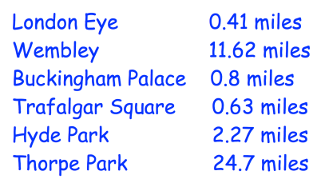
4. For the following questions, order the amounts of money from lowest to highest.
a) £6.74, £10, £1.99, £8, £3.30, £2 £1.99, £2, £3.30, £6.74, £8, £10 | b) 80p, £1, £0.09, 23p, £2.75, £0.82, £20 £0.09, 23p, 80p, £0.82, £1, £2.75
5. The distance of various landmarks from Big Ben are listed below. Arrange the landmarks in order, from closest to furthest.
London Eye
Trafalgar Square
Buckingham Palace
Hyde Park
Wembley
Thorpe Park
6. Arrange the measurements in order from smallest to largest.
a) 6.2m, 6.077m, 6.31m, 6.19m, 6.4m, 6.009m 6.009m, 6.077m, 6.19m, 6.2m, 6.31m, 6.4m | b) 5kg, 800g, 1.2kg, 90g, 0.6kg 90g, 0.6kg, 800g, 1.2kg, 5kg
7. The lengths of time that it takes to complete a jigsaw are below. Arrange the times in order, from longest to quickest.
0.5 hours, 1.25 hours, 100 minutes, 0.75 hours, 40 minutes, 2 hours, 1.5 hours, 180 minutes, 61 minutes, 0.25 hours. 180 minutes, 2 hours, 100 minutes, 1.5 hours, 1.25 hours, 61 minutes, 0.75 hours, 40 minutes, 0.5 hours, 0.25 hours
8. Always, sometimes or never? Given a reason for your answer.
A number with 2 decimal places is greater than a number with 3 decimal places.

Slide 4
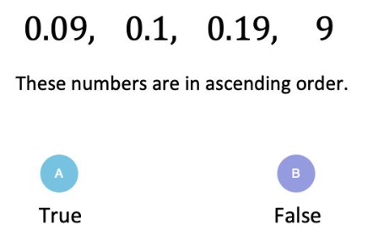
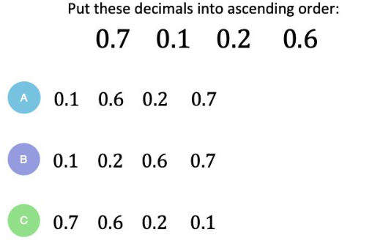
9. Calculate the median for each list of numbers:
a) 3.7, 3.5, 3.9, 3.4, 3.8 | b) 9.2, 2.9, 5.4, 1.8, 8.7
c) 4.6, 4.9, 14.1, 0.9, 1.2 | d) 8.13, 8.05, 8.24, 8.09, 8.15, 8.02
e) 1.53, 1.48, 1.59, 1.44, 2.11, 0.98 | f) 0.59, 1.24, 0.45, 1.34, 0.88, 2.01
3.7
5.4
4.6
8.165
1.505
1.06
Skills Check

